Slide 1
Name :SHARMILA.G REGISTER.NO :2422K1748 NM ID :autbru5h2422k1748 DEPARTMENT :B.SC.COMPUTER SCIENCE COLLEGE/ UNIVERSITY :ADHARSH VIDHYALAYA COLLEGE OF ARTS &SCIENCE FOR WOMEN/ BHARATHIAR UNIVERSITY

Slide 2
INTERACTIVE DIGITAL PORTFOLIE USING FRONT AND WEB DEVELOPMENT

Slide 3
AGENDA:
1.Problem Statement
2.Project Overview
3.End Users
4.Tools and Technologies
5.Portfolie design and Layout
6.Features and Functionality
7.Results and Screenshots
8.Coclusion

Slide 4
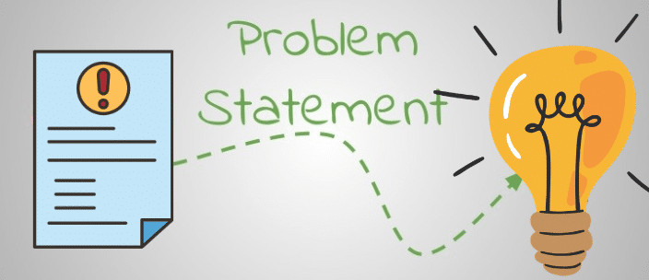
1.Problem Statement:
statement is a clear, concise description of a problem or gap between a current situation and a desired future state, explaining its significance and the context in which it occurs. It serves as a roadmap to focus efforts, foster creativity, and guide projects, research, or business initiatives towards effective solutions by defining what needs to be addressed, for whom, and why it's important.

Slide 5
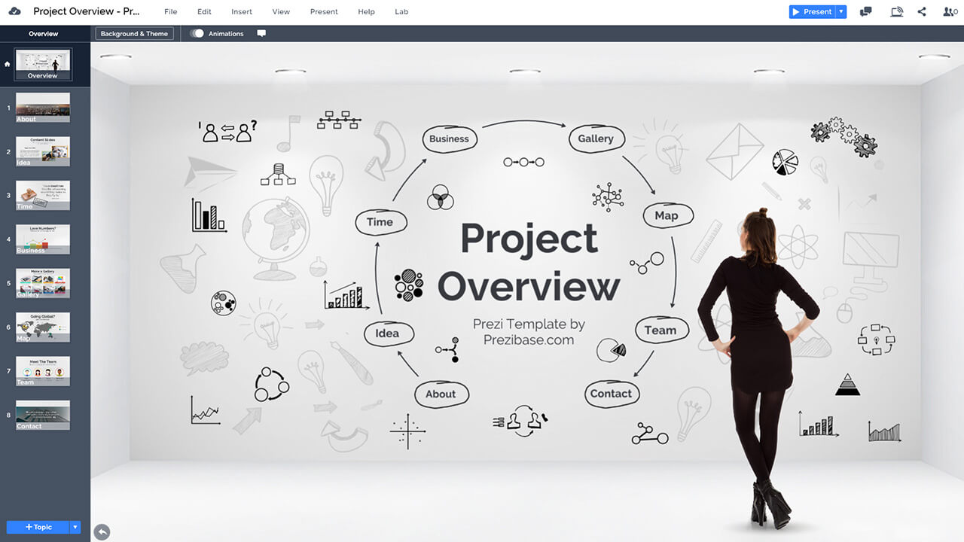
2.Project Overview:
A project overview is a concise summary document that provides a high-level framework of a project, detailing its goals, objectives, scope, key deliverables, timeline, resources, and budget. It serves as a central reference for team members, clients, and stakeholders to ensure everyone is aligned on the project's purpose and expected outcomes. The overview is a crucial document in the project initiation phase to gain support and serves as a quick reference throughout the project's lifecycle

Slide 6
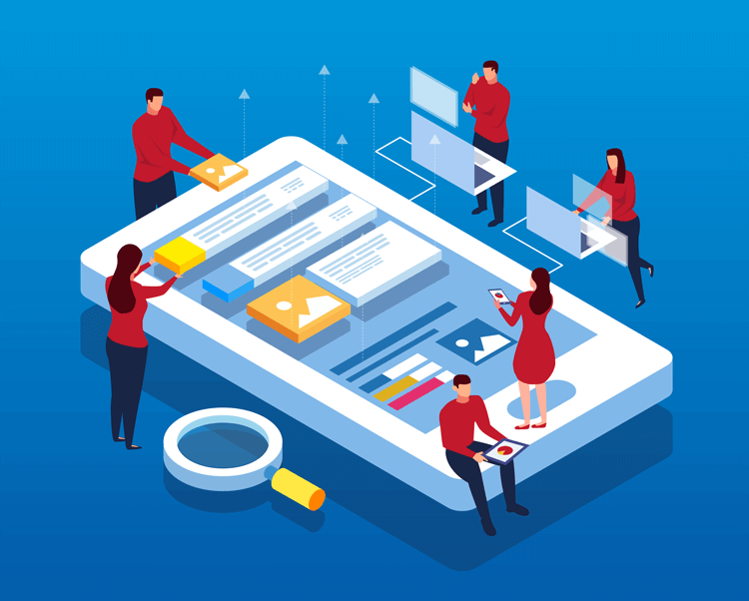
3.End Users:
An end user is a person or other entity that consumes or makes use of the goods or services produced by businesses. In this way, an end user may differ from a customer since the entity or person that buys a product or service may not be the one who actually uses An end user is a person or other entity that consumes or makes use of the goods or services produced by businesses. In this way, an end user may differ from a customer since the entity or person that buys a product or service may not be the one who actually uses it

Slide 7

4.Tools And Technologies:
Tools and technologies are closely related, where a tool is a specific device, implement, or software that performs a particular task, while technology is a broader concept encompassing the knowledge, processes, systems, and applications that allow us to solve problems or achieve goals, often by combining various tools. For example, a hammer is a tool for building, but the entire process of building, including the underlying engineering principles and blueprints, represents the technology

Slide 8
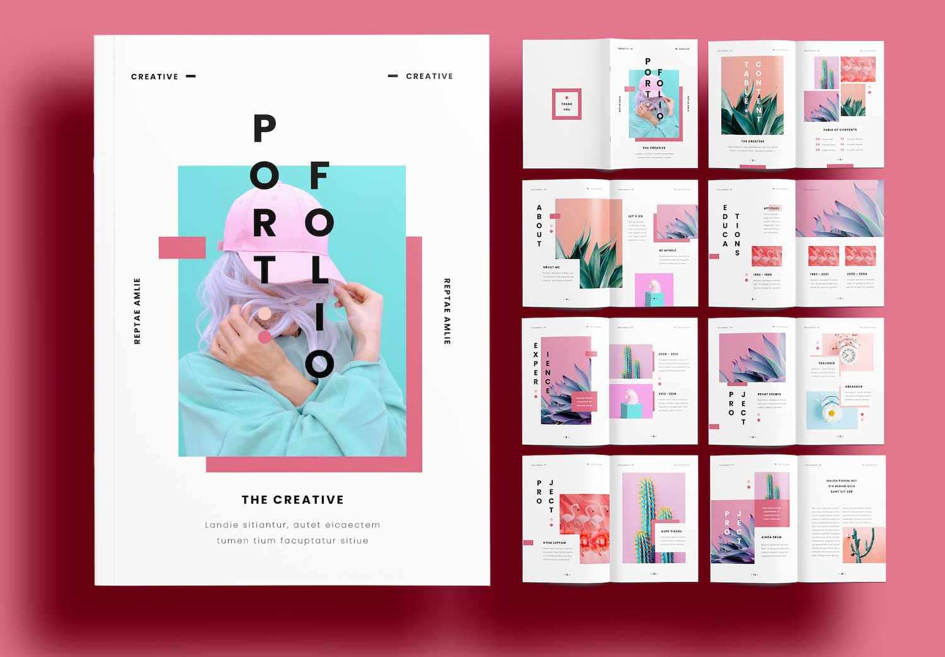
5.Portfolie design And Layout:
You can find free PDF portfolio design layout templates on platforms like Canva and Jotform, which offer various designs you can customize to showcase your best projects. A typical PDF portfolio includes a cover page, your best work, contact information, and an end page, all assembled into a single, integrated PDF file for easy reading and sharing.

Slide 9
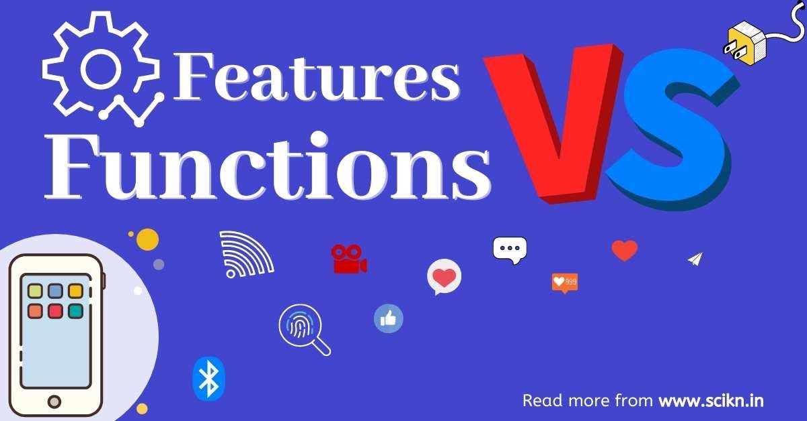
6.Features And Functionality:
Features are the tangible attributes or components of a product or service, such as a smartphone's camera or a software's user interface. Functionality describes the actions and overall capabilities of the product or service, including how well it performs its tasks to fulfill user needs and provide value. In essence, features are the "what" a product has, while functionality is the "how well" it does things.

Slide 10
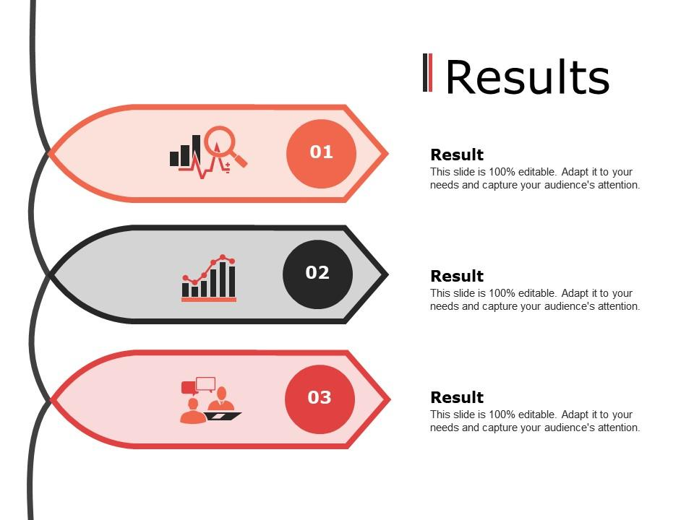
7.Results And Screenshot:
"Results and screenshots" refers to using digital images of a screen, called screenshots, to document and verify outcomes, especially in software testing. These screenshots can capture the visual state of a webpage, an application's user interface, or a search engine results page at a specific moment, helping to identify changes or errors over time. They are often integrated into reporting tools and can be generated automatically during testing or manually by users.

Slide 11
8.Conclusion:
In conclusion, HTML and CSS are fundamental technologies for building websites and web applications. HTML provides the structure and content, while CSS controls the presentation and layout. By understanding and leveraging these technologies, developers can create visually appealing, accessible, and user-friendly web experiences.

